Slide 1
What Is Schema?

Slide 2
Agenda
Schema Definition
Schema Architecture
Schema Example

Slide 3
Schema Definition
The structural view that shows the entire logical representation of the database.

Slide 4
Schema Architecture
The schema Architecture is divided into Physical and Logical.
Physical Database Schema: This schema handles how to store data in secondary storage.
Logical Database Schema: This handles logical constraints on the data being stored.

Slide 5
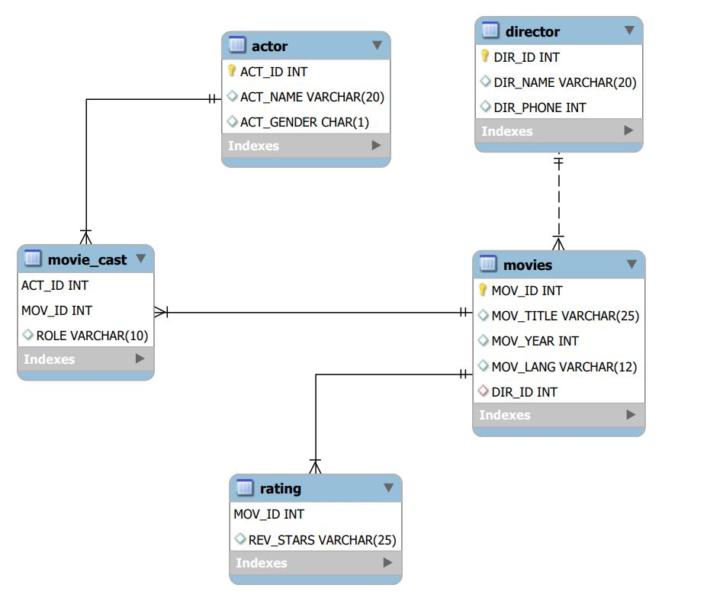
Schema Example

Slide 6
Summary
Schema is the logical representation of the data.
Schema architecture makes data flow easy.
DO NOT WRITE ANYTHING
HERE. LEAVE THIS SPACE FOR
WEBCAM

Slide 7
Thank You
Proprietary content. ©Great Learning. All Rights Reserved. Unauthorized use or distribution prohibited

